Slide 1
Instructions for BPMI Interviewee Expense Report
Reimbursable Interview Expenses

Slide 2
Meals
BPMI reimburses per diem for meals associated with your interview travel. Receipts are NOT required.
Breakfast
  For non-local candidates, when previous day or next day travel is required
    ex: your interview is Monday morning, and you fly/drive from State College, PA Sunday night, and you eat breakfast Monday morning at 6:30 am prior to your interview.
    ex: your interview is Monday afternoon, and you fly/drive home from Pittsburgh to Raleigh, NC Tuesday morning and eat breakfast at 6:30 am during your travel home.
Lunch
  for non-local candidates, when previous day or next day travel is required during lunch
    ex: your interview is Monday and you fly/drive from Troy, NY to Pittsburgh on Sunday, leaving at 10:30 am and you stop for lunch at 1:00 pm.
    ex: your interview is Monday afternoon and you fly/drive home from Pittsburgh to Troy, NY on Tuesday morning leaving at 8:00 am and you stop for lunch at 1:00 pm
Dinner
  For non-local candidates, when previous day or next day travel is required during dinner
    ex: your interview is Monday and you fly/drive from Philadelphia to Pittsburgh on Sunday evening leaving at 4:00 pm and you stop for dinner at 6:30 pm.
    ex: your interview is Monday and you fly/drive home from Pittsburgh to Philadelphia on Monday evening leaving at 4:00 pm and you stop for dinner at 6:30 pm.

Slide 3
Meal Per Diem Expense Amount
Expense the following amount for the associated site.
  Do not expense the actual cost of the meal.
Site | Breakfast | Lunch | Dinner
Pittsburgh | $14 | $16 | $29
Schenectady | $16 | $17 | $31

Slide 4
Reimbursement for Actual Expenses
BPMI reimburses the following expenses for interviewees for actual expenses:
  Airport Parking
  Baggage Fees – One bag
  Car Rental Gas
  Taxi/Shuttle (Uber)
  Tolls
  Personal Car mileage - Greater than 50 miles for local travel (receipt not required)
Receipts are required for transactions greater than $25.

Slide 5
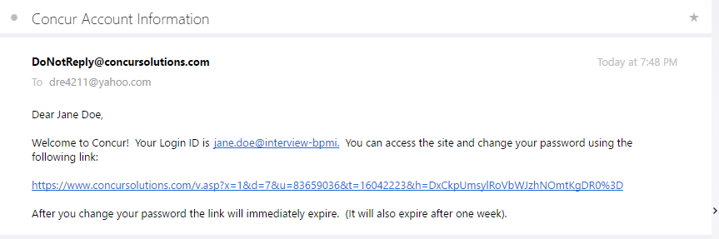
Getting Access for Reimbursement
Inform your Talent Acquisition professional you have expenses for reimbursement
Talent Acquisition professional will create an account in Concur Solutions
You will receive an email with login info and link to Concur Solutions to submit expenses

Slide 6
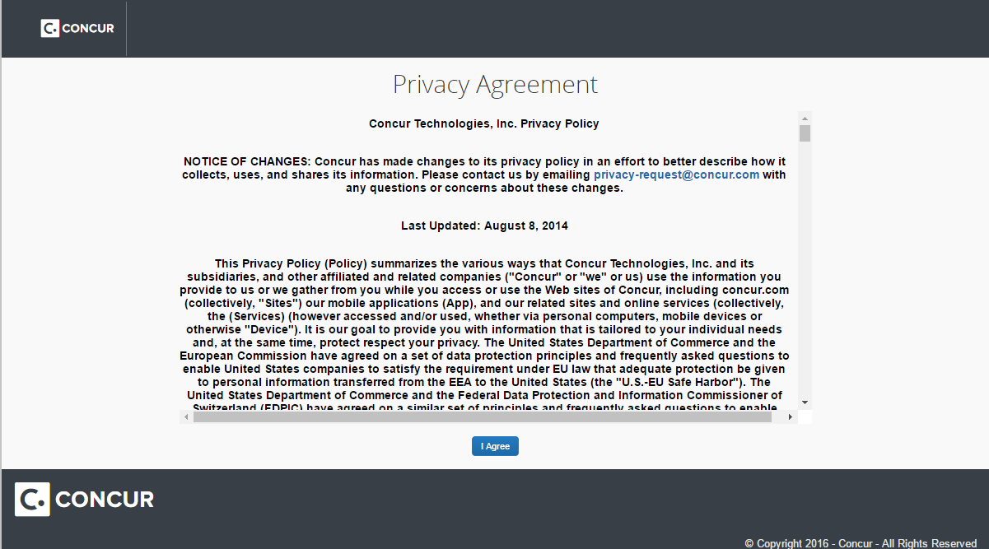
Privacy Agreement
Concur Privacy agreement opens in a new screen.

Slide 7
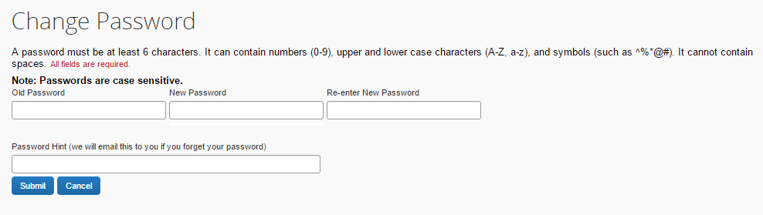
Change Password
After the agreement is complete, change your password.
Follow the instructions on the screen.

Slide 8
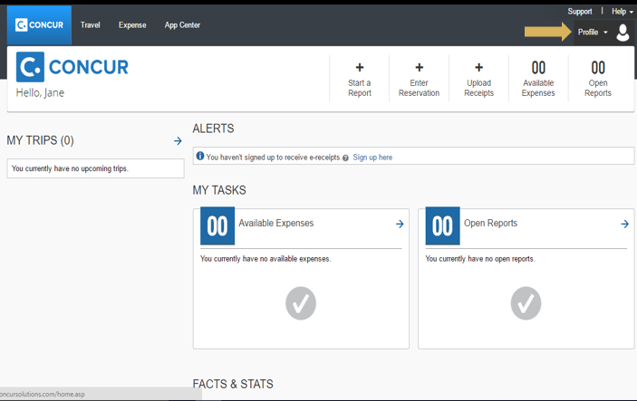
Update Your Profile
Click the profile drop-down button to begin

Slide 9
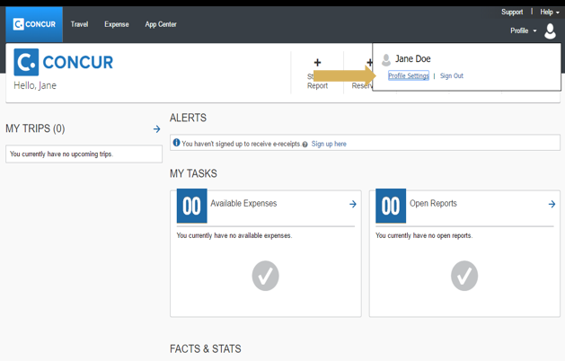
Profile Settings
Click Profile Settings

Slide 10
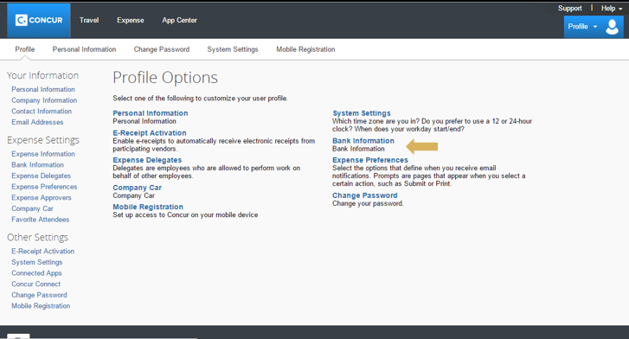
Update Bank Information
Update bank information
  Reimbursement can be direct deposited
Nothing else needs to be updated

Slide 11
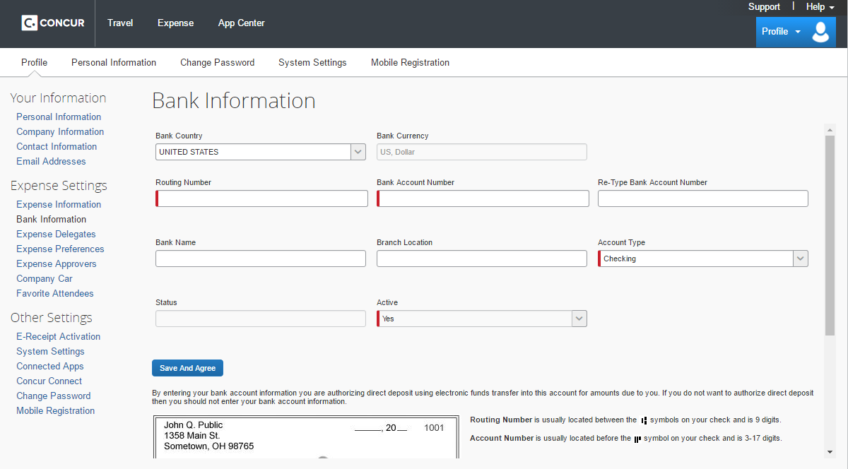
Update Bank Information
Complete the red fields
Your banking information is safe and secure. No one can see your information at BPMI or Concur.

Slide 12
Penny Test
Concur will put a penny into your bank account.
Then take the penny out of your account.
This is to ensure your account information is accurate for your reimbursement.
This process will take a few days, so start your report sooner than later!

Slide 13
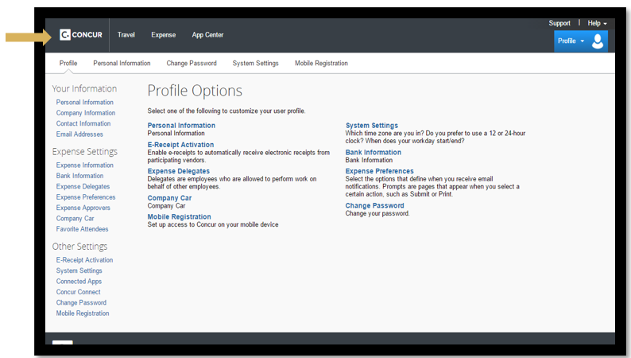
Starting Expense Report
Click Concur to go back to the home page.

Slide 14
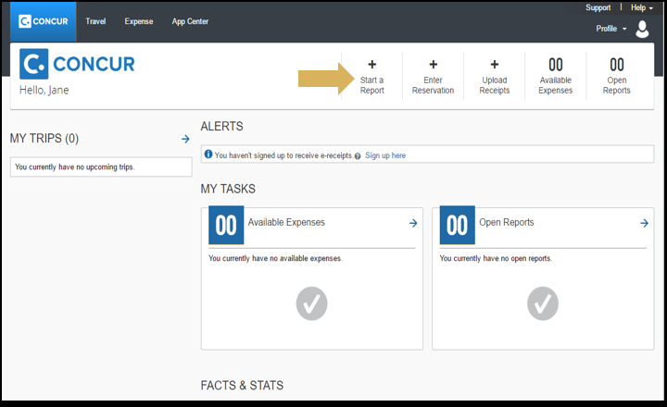
Start a Report
Click Start a Report

Slide 15
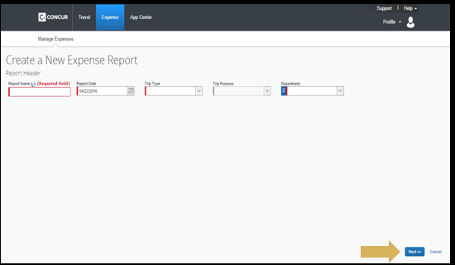
Creating a New Expense Report
Report Name: Your full name and date of interview (i.e. Jane Doe 01/01/2024)
Trip Type: Applicant Interview
Trip Purpose: Applicant Interview
Department: Human Resources
Click Next

Slide 16
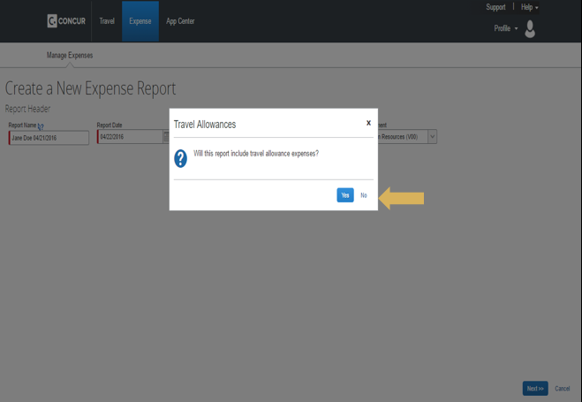
Travel Allowances
Click NO for Travel Allowances

Slide 17
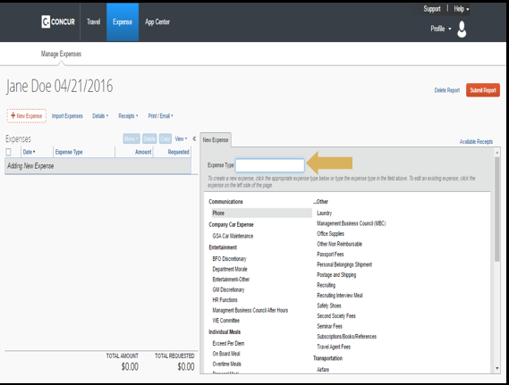
Interview Expenses
Type Interview into the expense type

Slide 18
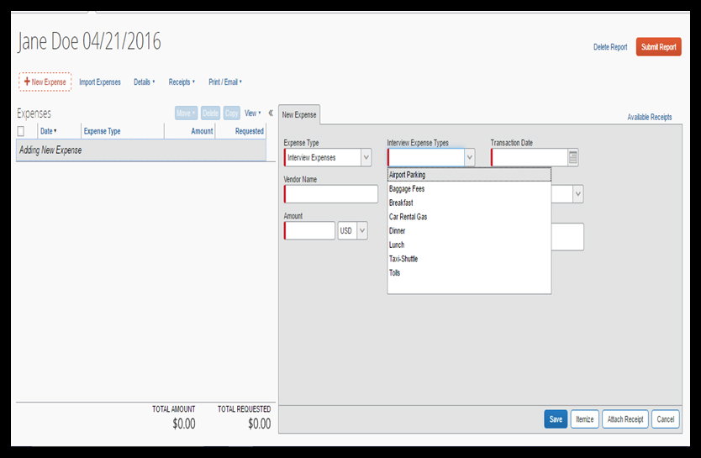
Interview Expenses
Expense Type: Interview Expenses
Interview Expense Type: Select appropriate
Transaction Date: date of transaction
Vendor Name: Name of Vendor
Amount: Amount of expense
Click Save
Repeat for all interview expenses
  See next slide for Personal Car
  Mileage Reimbursement

Slide 19
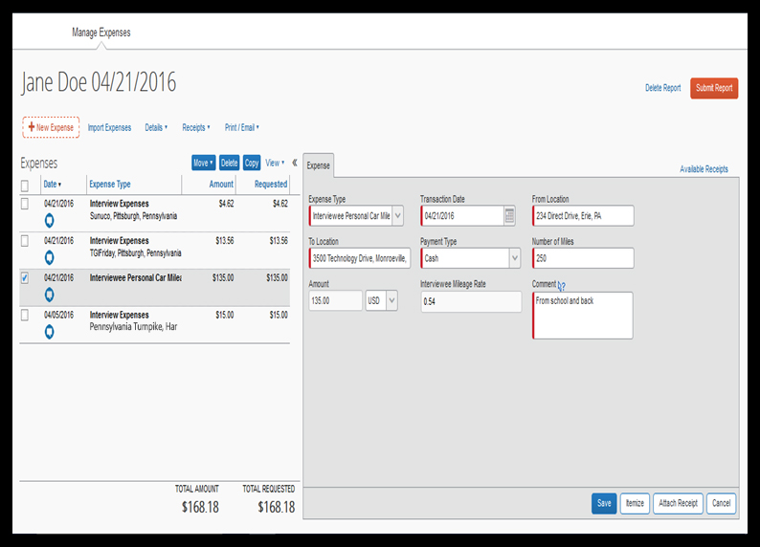
Personal Car Mileage Reimbursement
Expense type: Interviewee Personal Car Mileage
Personal Car mileage is only reimbursable for mileage greater than 50 miles one-way.
Include address for To and From Location

Slide 20
Receipts
Because BPMI has a direct bill arrangement to cover the airline, hotel, and car rental, receipts are not required for these expenses.
Most expense reports will not require receipts.
Personal Car Mileage does not require a receipt.
Meals do not require a receipt.
If a receipt needs to be attached to the report, it must be done electronically.
  This is done by uploading the receipt to Concur
    Take a picture with a Smartphone using the Concur App (which must be downloaded to your device)
    Upload a PDF copy of the receipt
See Next Slide for further instructions on receipts.

Slide 21
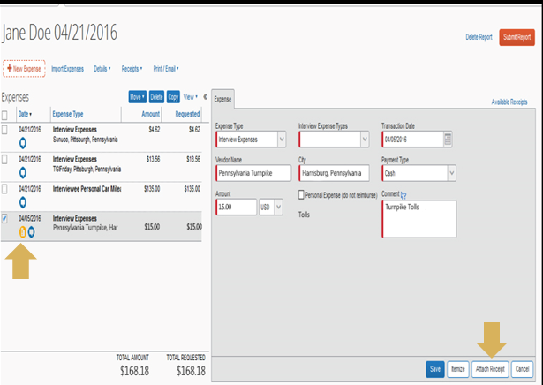
Uploading a Receipt
Select the line that needs a receipt
  Yellow symbol means receipt is required
Click Attach Receipt

Slide 22
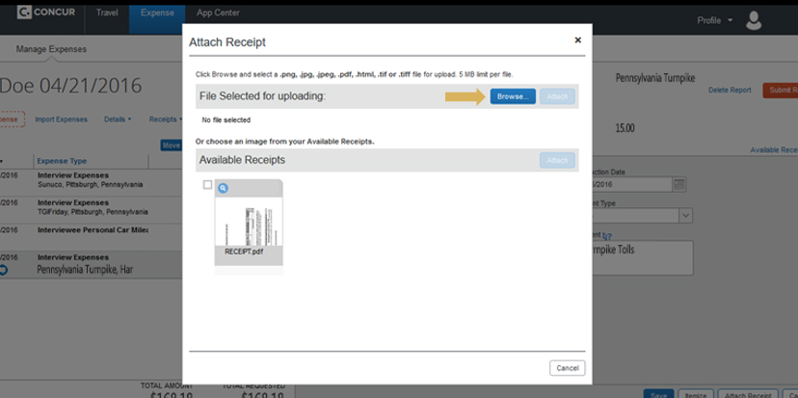
Attaching Receipt
If you took a picture via the app, it will show up in Available Receipts.
If you did another method, click Browse to find your photo to attach.

Slide 23
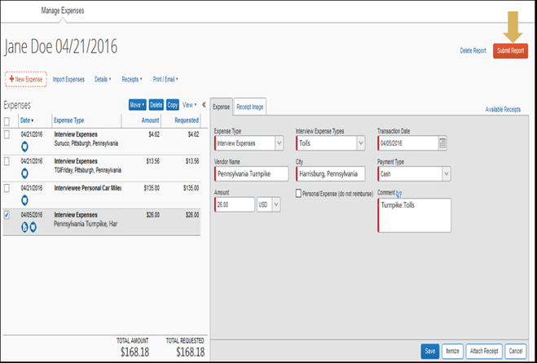
Submit Report
After receipts are attached and exceptions are resolved, the expense report can be submitted
Click Submit Report
se report can be submitted

Slide 24
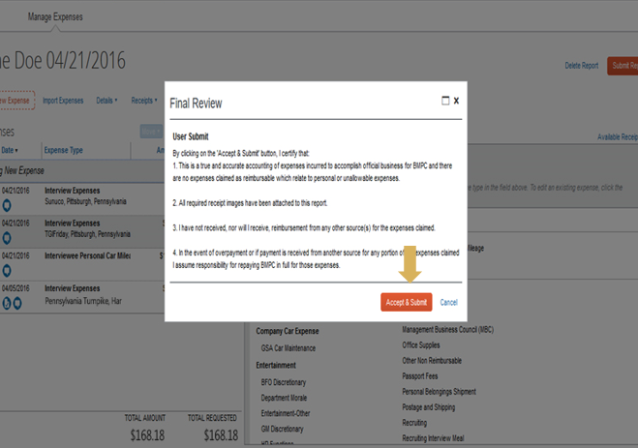
Final Review
Click Accept and Submit

Slide 25
Timing of Payment
There are various reviews an expense report must go through once submitted.
Once the expense report is approved, it may take up to two weeks for reimbursement.

Slide 26
Troubleshooting
If your report has an error, it will be returned to you. You will be required to make any necessary updates and resubmit.
If you are unable to figure out the problem, contact your Talent Acquisition professional to help you resolve these issues.

